Slide 1
Testing
Instructor: Mehroze Khan

Slide 2
Software Faults and Failures Why Does Software Fail?
Wrong requirement: not what the customer wants
Missing requirement
Requirement impossible to implement
Faulty design
Faulty code
Improperly implemented design

Slide 3

Objective of Testing
Objective of testing: discover faults
A test is successful only when a fault is discovered
Fault identification is the process of determining what fault caused the failure
Fault correction is the process of making changes to the system so that the faults are removed

Slide 4
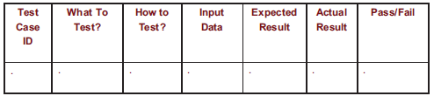
Elements of a Test Case
Purpose
Input
Expected Output
Actual Output
Sample Format:

Slide 5
Types of Faults
Algorithmic fault
When a component’s algorithm or logic does not produce the proper output for a given input because something is wrong with the processing steps
These faults are sometimes easy to spot just by reading through the program (called desk checking) or by submitting input data from each of the different classes of data that we expect the program to receive during its regular working
Typical algorithmic faults include:
branching too soon
branching too late
testing for the wrong condition
forgetting to initialize variables or set loop invariants
forgetting to test for a particular condition (e.g., when division by zero might occur)
comparing variables of inappropriate data types

Slide 6
Types of Faults
Syntax fault
Computation and precision fault
A formula’s implementation is wrong or does not compute result to required number of decimal places
Documentation fault
Documentation doesn’t match what program does
Stress or overload faults
Occur when the data structures are filled past their specified capacity.

Slide 7
Types of Faults
Capacity or boundary faults
System’s performance not acceptable when certain limits are reached
Timing or coordination faults
Occur when the code coordinating several processes executing simultaneously or in a carefully defined sequence is inadequate
Throughput or performance faults
System does not perform at the speed prescribed by requirements
Recovery faults
Can occur when a failure is encountered and the system does not behave as the designer's desire or as the customer requires

Slide 8
Different Level of Failure Severity
Catastrophic: causes death or system loss
Critical: causes severe injury or major system damage
Marginal: causes minor injury or minor system damage
Minor: causes no injury or system damage

Slide 9
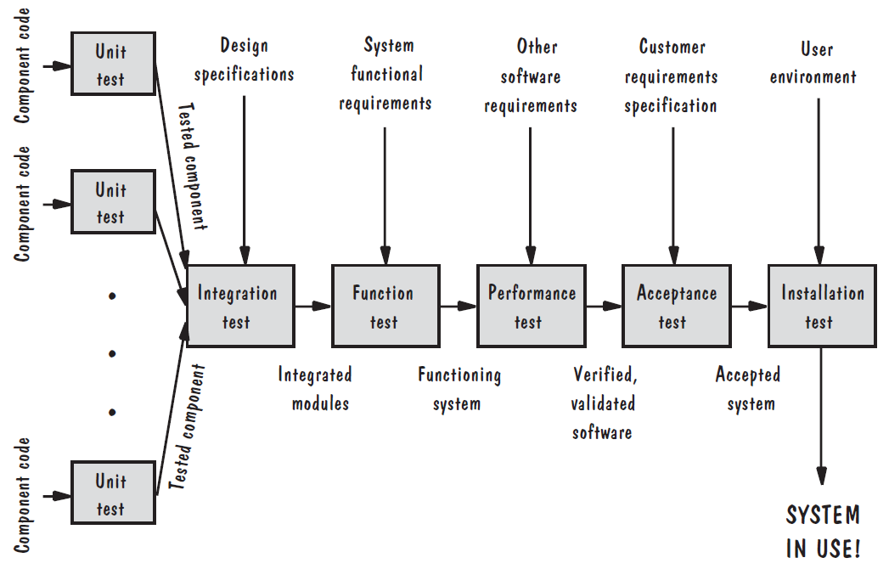
Testing Steps

Slide 10
Testing Issues Attitude Toward Testing
Programs are viewed as components of a larger system, not as the property of those who wrote them

Slide 11
Testing Issues Who Performs the Test?
Independent test team
avoid conflict
personal responsibility vs need to discover faults
improve objectivity
allow testing and coding concurrently

Slide 12
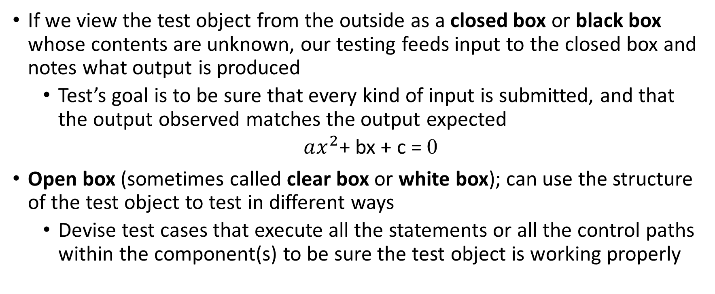
Testing Issues Views of the Test Objects
If we view the test object from the outside as a closed box or black box whose contents are unknown, our testing feeds input to the closed box and notes what output is produced
Test’s goal is to be sure that every kind of input is submitted, and that the output observed matches the output expected
$ax^{2}$+ bx + c = 0
Open box (sometimes called clear box or white box); can use the structure of the test object to test in different ways
Devise test cases that execute all the statements or all the control paths within the component(s) to be sure the test object is working properly

Slide 13
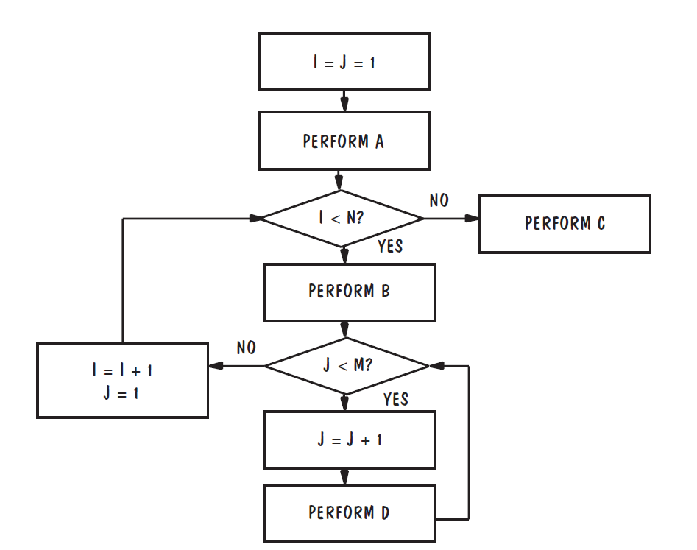
Testing Issues Views of the Test Objects
If n and m are each equal to 100,000, a test case would have to loop 10 billion times to exercise all logic paths

Slide 14
Testing Issues Views of the Test Objects
Closed box or black box: functionality of the test objects
Equivalence Class, Boundary Value Analysis, Scenario-based, Decision Table based, State Machine based…
Clear box or white box: structure of the test objects
Control Flow
Basis Path, Branch, Statement, Decision…
Data Flow
Du Path, All-uses Path

Slide 15
Black Box Testing Equivalence Class Partitioning
In this technique, input data units are divided into equivalent partitions that can be used to derive test cases which reduces time required for testing because of small number of test cases.
Example, we have a field of Product Id and we have only 10 products whose product Id are 1, 2 … 10. So, our Product Id field only accepts the digits from range 1 to 10
Invalid | Valid | Invalid
<1 | 1-10 | 10<

Slide 16
Black Box Testing Equivalence Class Partitioning
Take at least one representative value from every partition.
If the representative value passes the test, the whole partition is considered pass or valid and vice versa
Invalid | Valid | Invalid
<1 | 1-10 | 10<
-5
(Representative value)
7
(Representative value)
95
(Representative value)

Slide 17
Black Box Testing Equivalence Class Partitioning (Guidelines for defining equivalence classes)
If an input condition specifies a range, one valid and two invalid equivalence classes are defined
Input range: 1 – 10 Eq classes: {1..10}, {x < 1}, {x > 10}
If an input condition requires a specific value, one valid and two invalid equivalence classes are defined
Input value: 250 Eq classes: {250}, {x < 250}, {x > 250}
If an input condition specifies a member of a set, one valid and one invalid equivalence class are defined
Input set: {-2.5, 7.3, 8.4} Eq classes: {-2.5, 7.3, 8.4}, {any other x}
If an input condition is a Boolean value, one valid and one invalid class are defined
Input: {true condition} Eq classes: {true condition}, {false condition}

Slide 18
Black Box Testing Equivalence Class Partitioning (Triangle Problem)
Specification
Input is three integers (sides of a triangle: a, b, c)
Each side must be a positive number less or equal to 20.
Output type of the triangle:
Equilateral: if a = b = c
Isosceles: if 2 pairs of sides are equals
Scalene if no pair of sides is equal
Not a triangle: if a ≥ b + c, b ≥ a + c, or c ≥ a + b

Slide 19
Black Box Testing Equivalence Class Partitioning (Triangle Problem)
Test cases based on invalid input range
TC Id | A | B | C | EO
1 | -1 | 15 | 15 | Value of A not in valid range
2 | 15 | -1 | 15 | Value of B not in valid range
3 | 15 | 15 | -1 | Value of C not in valid range
4 | 21 | 15 | 15 | Value of A not in valid range
5 | 15 | 21 | 15 | Value of B not in valid range
6 | 15 | 15 | 21 | Value of C not in valid range

Slide 20
Black Box Testing Equivalence Class Partitioning (Triangle Problem)
Test cases based on valid input range
TC Id | A | B | C | EO
1 | 15 | 15 | 15 | Equilateral
2 | 12 | 20 | 12 | Isosceles
3 | 5 | 6 | 7 | Scalene
4 | 1 | 2 | 10 | Not a triangle

Slide 21
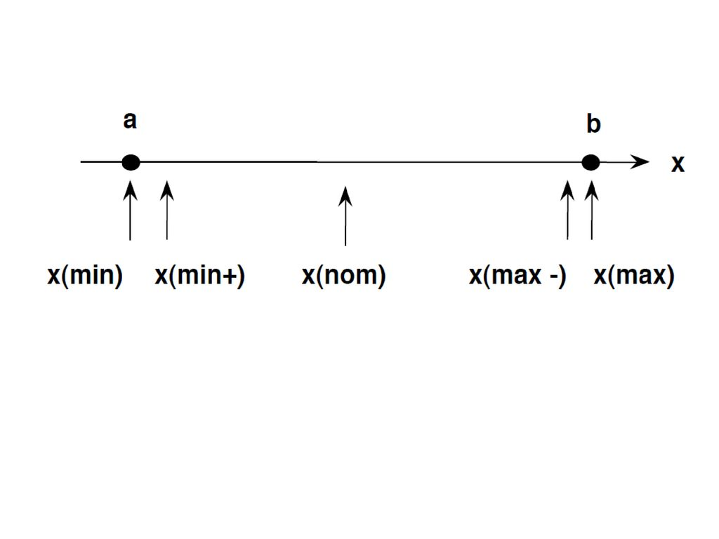
Black Box Testing Boundary Value Analysis (Generalized BVA)
It is used to test boundary values because the input values near the boundary have higher chances of error.
Select input variable values at their:
Minimum
Just above the minimum
A nominal value
Just below the maximum
Maximum

Slide 22
Black Box Testing Boundary Value Analysis
It is used to test boundary values because the input values near the boundary have higher chances of error.

Slide 23
Black Box Testing Boundary Value Analysis (Triangle Problem)
Generalized BVA
No of test cases = 4n+1
TC Id | A | B | C | EO
1 | 1 | 10 | 10 | Isosceles
2 | 2 | 10 | 10 | Isosceles
3 | 10 | 10 | 10 | Equilateral
4 | 19 | 10 | 10 | Isosceles
5 | 20 | 10 | 10 | Not a triangle
6 | 10 | 1 | 10 | Isosceles
7 | 10 | 2 | 10 | Isosceles
8 | 10 | 10 | 10 | Equilateral
9 | 10 | 19 | 10 | Isosceles
10 | 10 | 20 | 10 | Not a triangle
11 | 10 | 10 | 1 | Isosceles
12 | 10 | 10 | 2 | Isosceles
13 | 10 | 10 | 10 | Equilateral
14 | 10 | 10 | 19 | Isosceles
15 | 10 | 10 | 20 | Not a triangle

Slide 24
Black Box Testing Boundary Value Analysis (Triangle Problem)
Generalized BVA
No of test cases = 4n+1
TC Id | A | B | C | EO
1 | 1 | 10 | 10 | Isosceles
2 | 2 | 10 | 10 | Isosceles
3 | 10 | 10 | 10 | Equilateral
4 | 19 | 10 | 10 | Isosceles
5 | 20 | 10 | 10 | Not a triangle
6 | 10 | 1 | 10 | Isosceles
7 | 10 | 2 | 10 | Isosceles
8 | 10 | 10 | 10 | Equilateral
9 | 10 | 19 | 10 | Isosceles
10 | 10 | 20 | 10 | Not a triangle
11 | 10 | 10 | 1 | Isosceles
12 | 10 | 10 | 2 | Isosceles
13 | 10 | 10 | 10 | Equilateral
14 | 10 | 10 | 19 | Isosceles
15 | 10 | 10 | 20 | Not a triangle

Slide 25
Black Box Testing Boundary Value Analysis (Triangle Problem)
Generalized BVA
No of test cases = 4n+1
TC Id | A | B | C | EO
1 | 1 | 10 | 10 | Isosceles
2 | 2 | 10 | 10 | Isosceles
3 | 10 | 10 | 10 | Equilateral
4 | 19 | 10 | 10 | Isosceles
5 | 20 | 10 | 10 | Not a triangle
6 | 10 | 1 | 10 | Isosceles
7 | 10 | 2 | 10 | Isosceles
8 | 10 | 19 | 10 | Isosceles
9 | 10 | 20 | 10 | Not a triangle
10 | 10 | 10 | 1 | Isosceles
11 | 10 | 10 | 2 | Isosceles
12 | 10 | 10 | 19 | Isosceles
13 | 10 | 10 | 20 | Not a triangle

Slide 26
Black Box Testing Boundary Value Analysis (Robustness BVA)
It is used to test boundary values because the input values near the boundary have higher chances of error.
Select input variable values at their:
Just below the minimum
Minimum
Just above the minimum
A nominal value
Just below the maximum
Maximum
Just above the maximum
x (min -)
x (max +)

Slide 27
Black Box Testing Boundary Value Analysis (Triangle Problem)
Robustness BVA
No of test cases = 6n+1
TC Id | A | B | C | EO
1 | 0 | 10 | 10 | Value of A not in valid range
2 | 1 | 10 | 10 | Isosceles
3 | 2 | 10 | 10 | Isosceles
4 | 10 | 10 | 10 | Equilateral
5 | 19 | 10 | 10 | Isosceles
6 | 20 | 10 | 10 | Not a triangle
7 | 21 | 10 | 10 | Value of A not in valid range
8 | 10 | 0 | 10 | Value of B not in valid range
9 | 10 | 1 | 10 | Isosceles
10 | 10 | 2 | 10 | Isosceles
11 | 10 | 19 | 10 | Isosceles
12 | 10 | 20 | 10 | Not a triangle
13 | 10 | 21 | 10 | Value of B not in valid range
14 | 10 | 10 | 0 | Value of C not in valid range
15 | 10 | 10 | 1 | Isosceles
16 | 10 | 10 | 2 | Isosceles
17 | 10 | 10 | 19 | Isosceles
18 | 10 | 10 | 20 | Not a triangle
19 | 10 | 10 | 21 | Value of C not in valid range

Slide 28
White Box Testing Control Flow Testing
The control flow graph shows all the paths that can be traversed during a program execution.
The aim is to determine the execution paths through a module of program code and then create and execute test cases to cover those paths.
A control flow graph is a directed graph.
It is mostly used in unit testing.

Slide 29
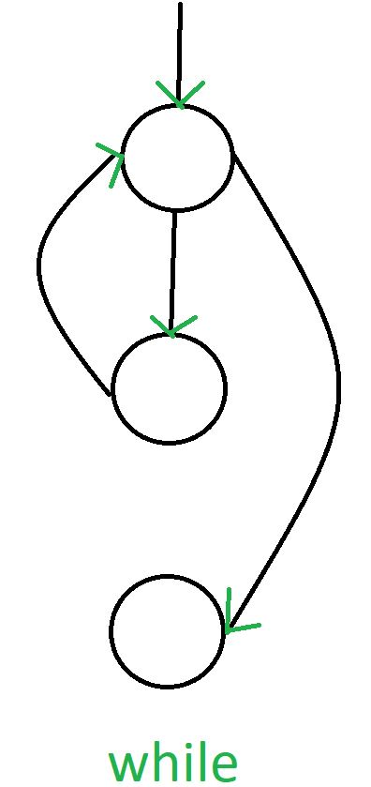
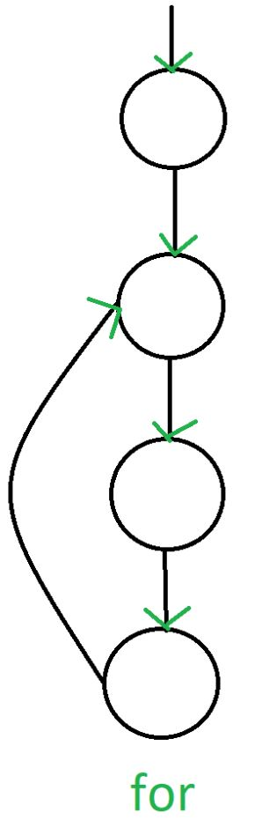
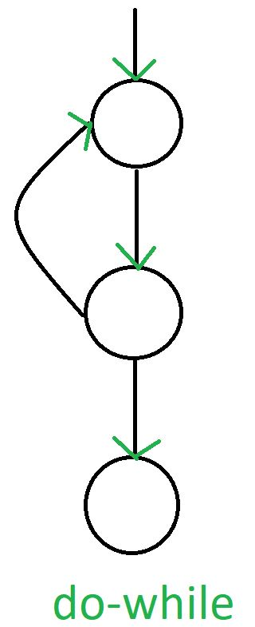
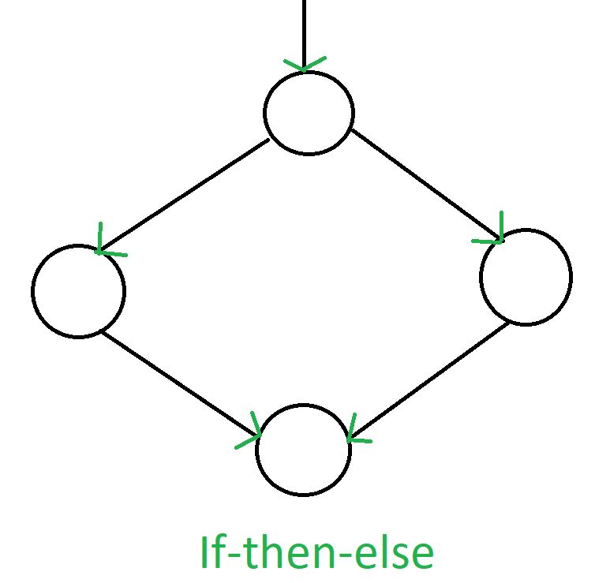
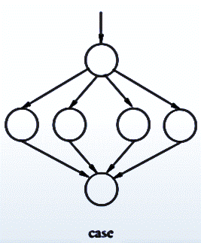

White Box Testing (Control Flow Graphs)
switch

Slide 30
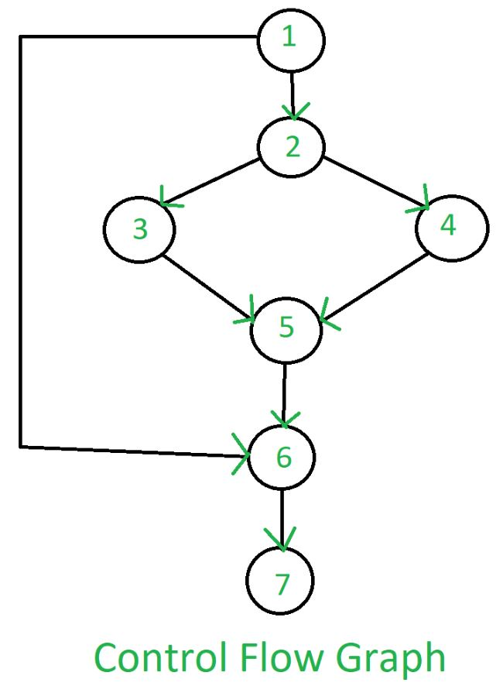
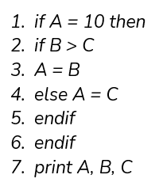
White Box Testing Control Flow Testing

Slide 31
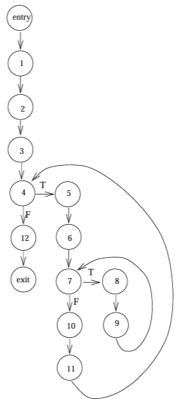
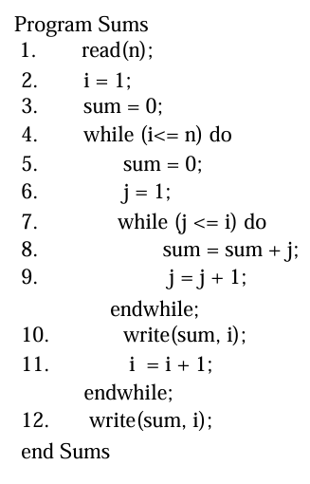
White Box Testing Control Flow Testing
Control Flow Graph
Notes:
13-12+2 = 3

Slide 32
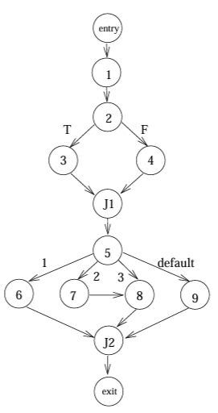
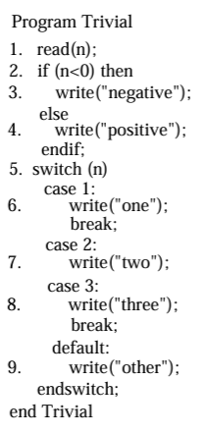
White Box Testing Control Flow Testing
Control Flow Graph
Notes:
14-11+2=5

Slide 33
White Box Testing Control Flow Testing
Program
Control Flow Graph
1
Statement testing
Branch testing
Path testing
…

Slide 34
White Box Testing Control Flow Testing
Cyclomatic Complexity is the quantitative measure of the number of linearly independent paths in it.
It is a software metric used to describe the complexity of a program.
Complexity is computed as:
Cyclomatic complexity V(G) for a flow graph G is defined as
V(G) = E − N + 2
where E is the number of flow graph edges and N is the number of flow graph nodes.

Slide 35
White Box Testing Control Flow Testing
1
Cyclomatic Complexity:
V(G) = 10 edges − 10 nodes + 2 = 2.

Slide 36
White Box Testing Control Flow Testing
1
There are two independent paths:
Path 1: 1-2-3-4-5-6-8-9-10
Path 2: 1-2-3-4-5-7-8-9-10

Slide 37
Levels of Testing
Module testing, component testing, or unit testing
Integration testing
System Testing
Function testing
Performance testing
Acceptance testing
Installation testing

Slide 38
Levels of Testing Testing Organization Illustrated

Slide 39
Unit Testing Code Review
Code walkthrough
In a walkthrough, you present your code and accompanying documentation to the review team, and the team comments on their correctness.
Code inspection
In an inspection, the review team checks the code and documentation against a prepared list of concerns. It is more formal.

Slide 40
Unit Testing
Testing the unit for correct functionality
Testing the unit for correct execution

Slide 41
Unit Testing Steps in Testing
Determining test objectives
Selecting test cases
Executing test cases

Slide 42
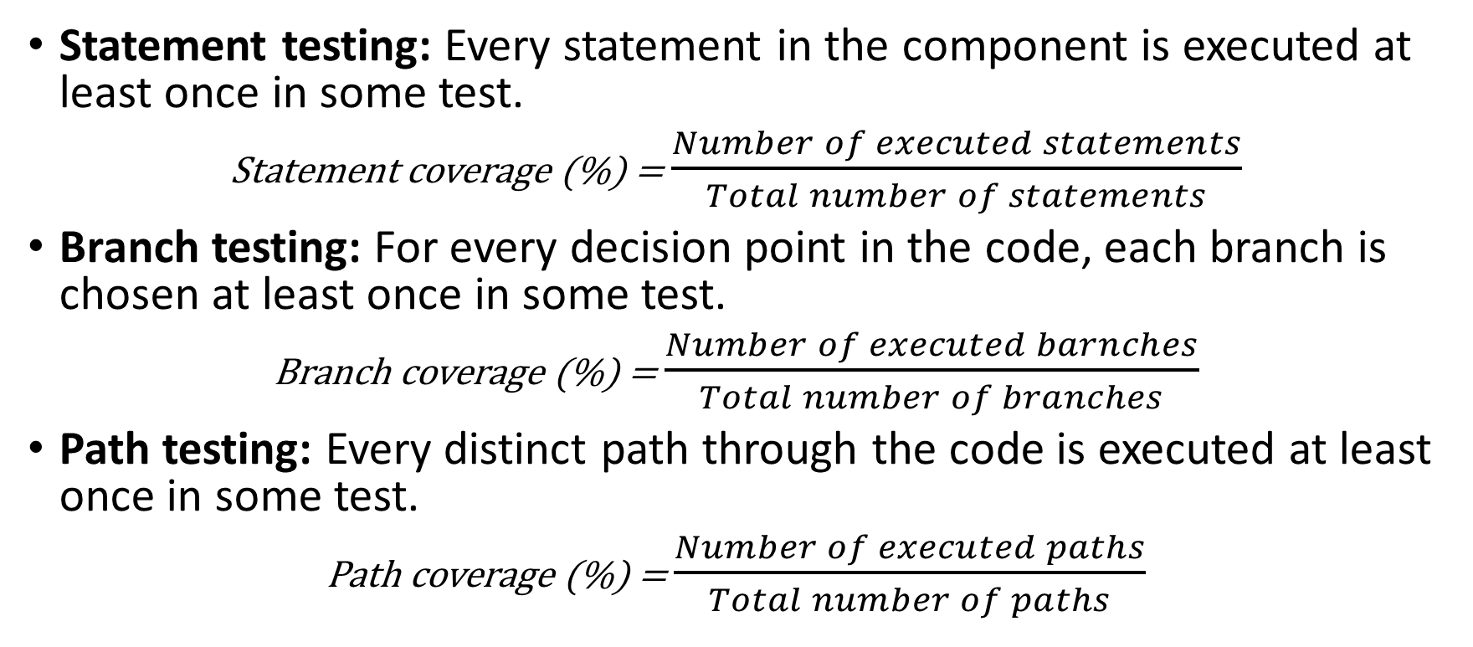
Unit Testing Whitebox Test Thoroughness
Statement testing: Every statement in the component is executed at least once in some test.
Statement coverage (%) = $\frac{Number of executed statements}{Total number of statements}$
Branch testing: For every decision point in the code, each branch is chosen at least once in some test.
Branch coverage (%) = $\frac{Number of executed barnches}{Total number of branches}$
Path testing: Every distinct path through the code is executed at least once in some test.
Path coverage (%) = $\frac{Number of executed paths}{Total number of paths}$

Slide 43
Example
void Result (int x, int y)
{ int result = x + y;
if (result > 0)
print << “Positive”;
else if (result < 0)
print << “Negative”;
}

Slide 44
References
Shari PFleeger, Joanne Atlee, Software Engineering: Theory and Practice, 4th Edition
Roger S. Pressman, Software Engineering A Practitioner’s Approach, 9th Edition. McGrawHill

